Slide 1

Select Topics in Python
Supervised Learning
Adwith Malpe

Slide 2
Objectives
Objectives
What is supervised learning?
What is the process of supervised learning?
Supervised learning algorithms.
Applications of supervised learning.

Slide 3
What is Supervised Learning?
What is supervised learning?
Branch of machine learning that refers to a class of systems and algorithms that establish a predictive model using data samples with known outcomes.
Basic concept: train a model using labeled input and output data and then apply the model to new data to make predictions.
Known ground truth
Can be broken down into classification and regression problems.
Classification: output variable is a category.
Regression: output variable is a real value.

Slide 4
Supervised Learning Process
Supervised learning process
Gather labeled training data.
Split the labeled data into a training set and test set.
Train the model.
Test the model.
Evaluate the model using data it has not seen.

Slide 5
Supervised Learning Algorithms
Supervised learning algorithms
Perceptrons.
Logistic regression.
Support vector machines.
Decision trees.
K-nearest neighbors.

Slide 6
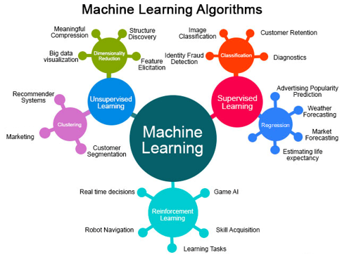
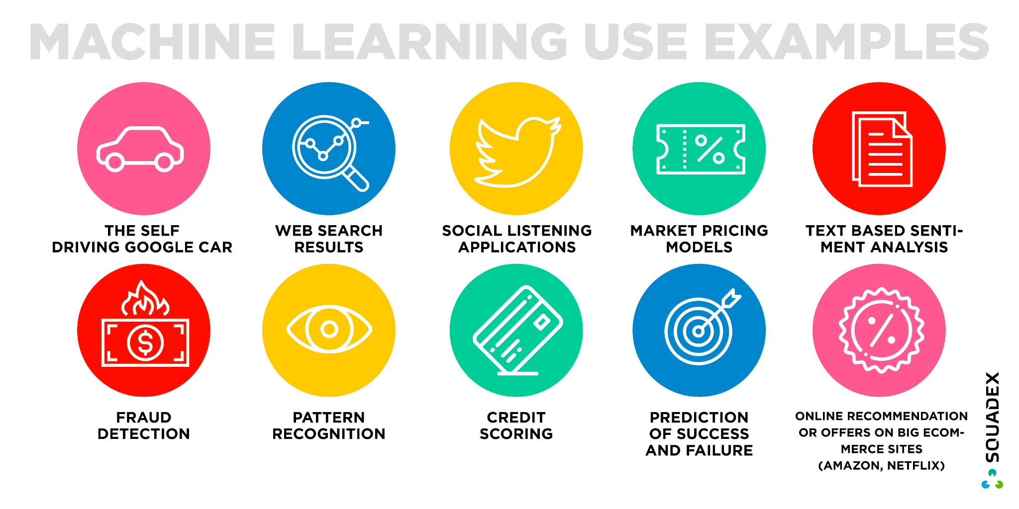
Applications of Supervised Learning

